Slide 1
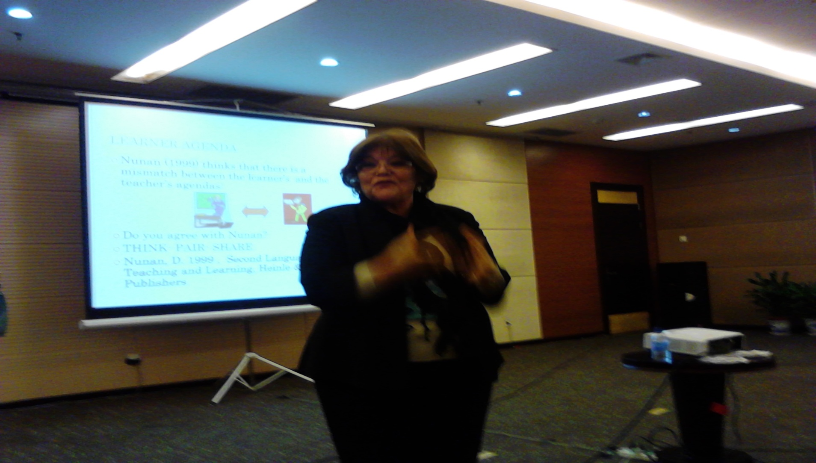

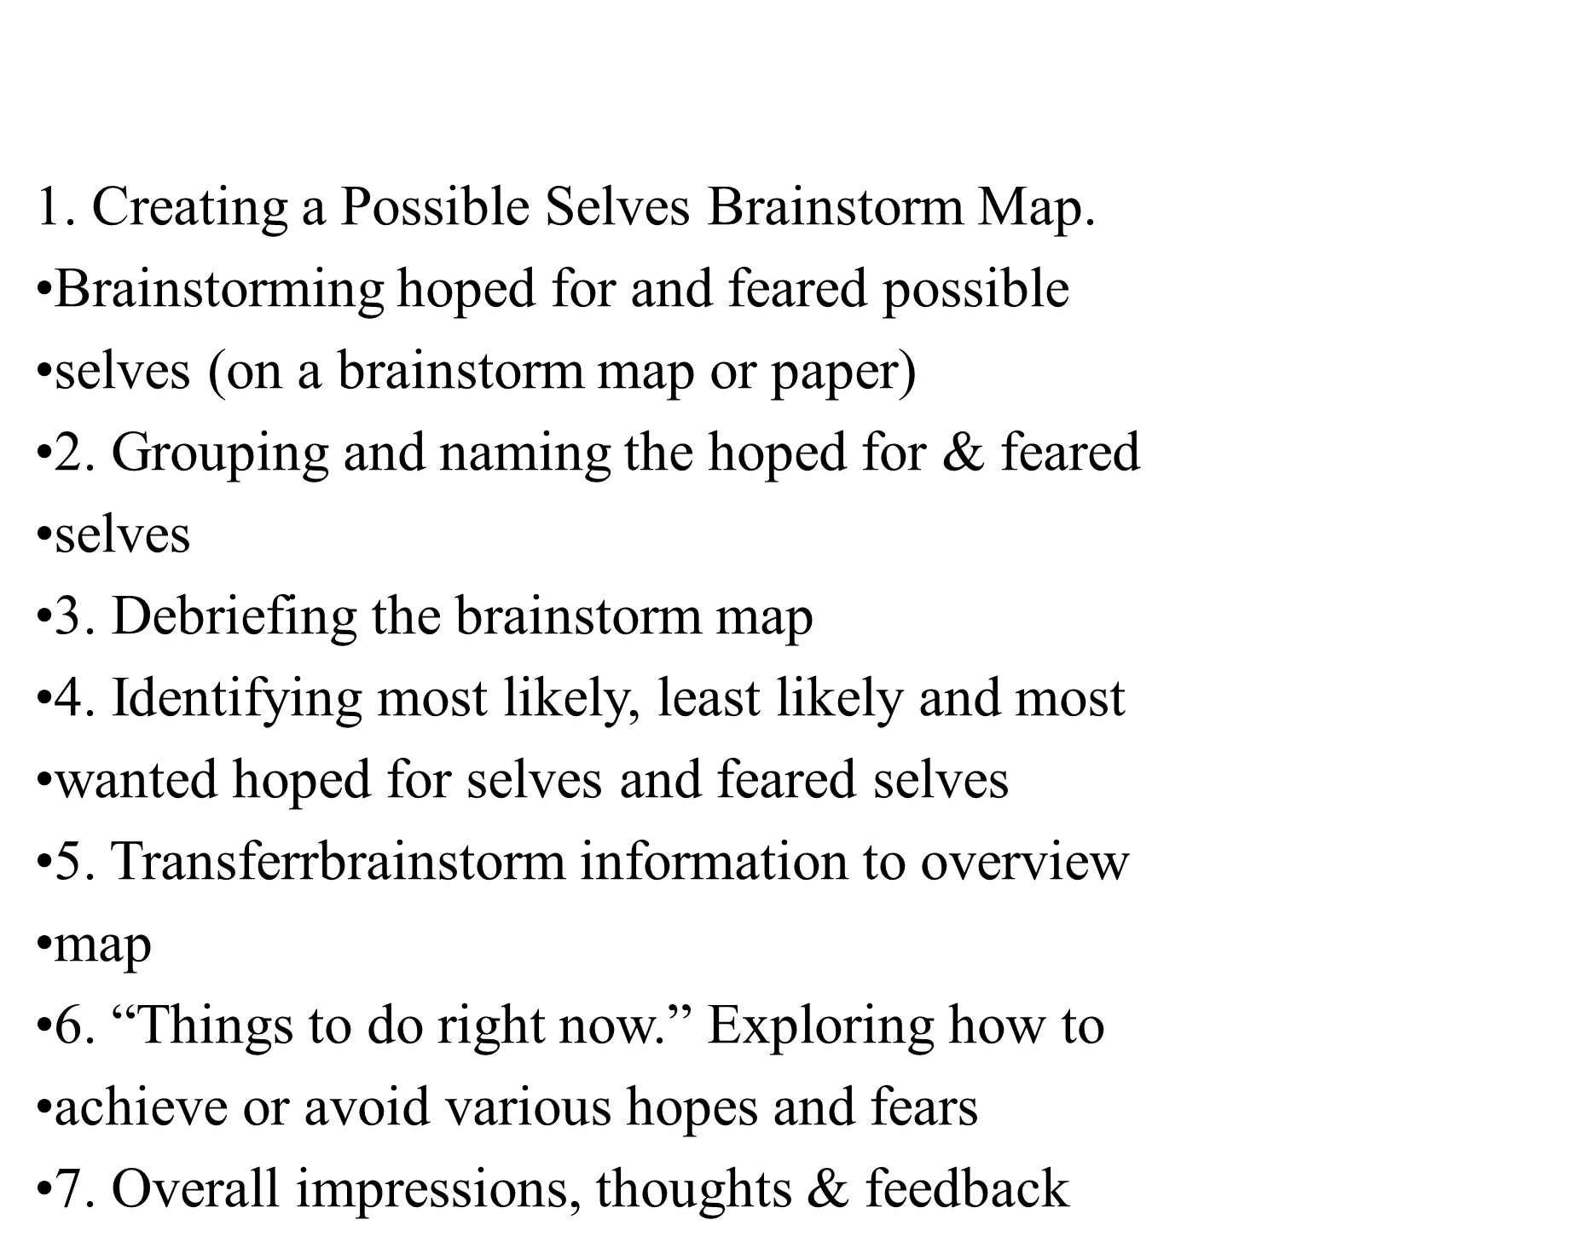
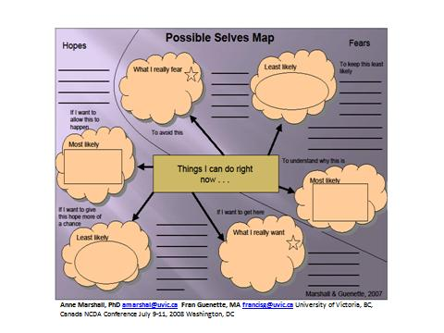
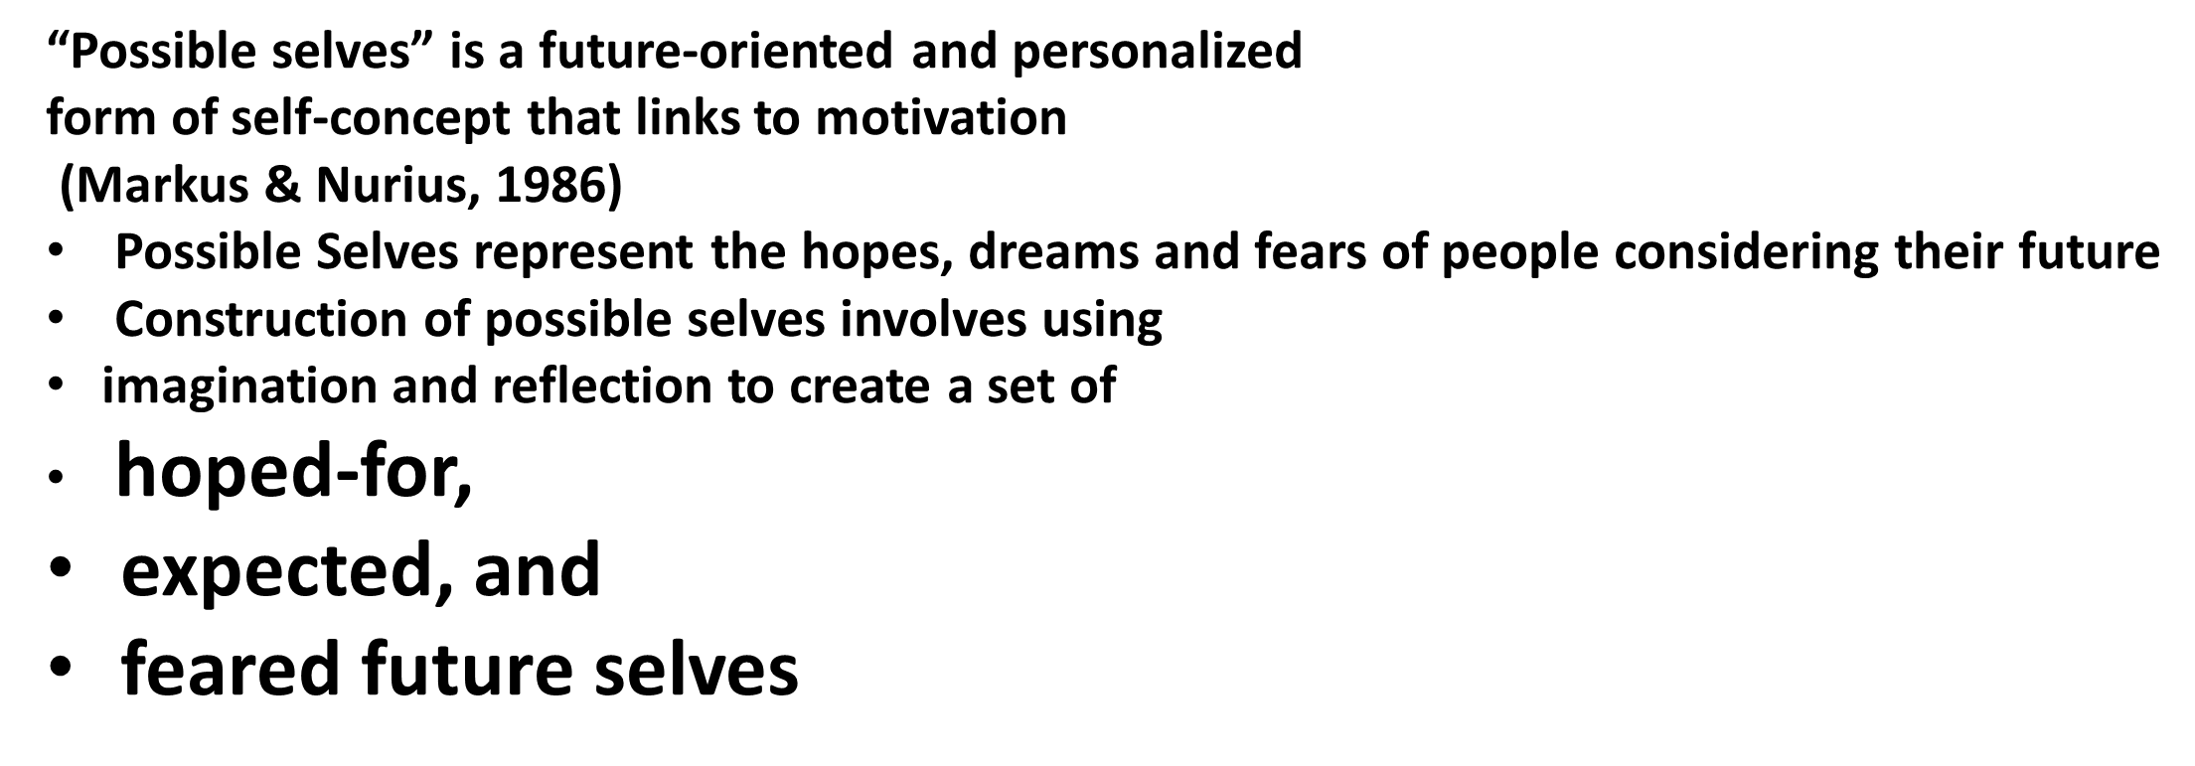
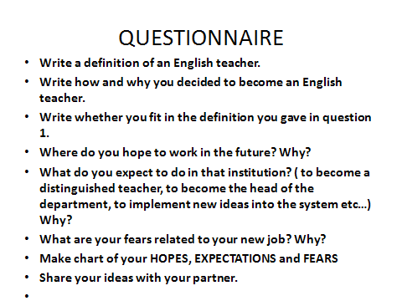
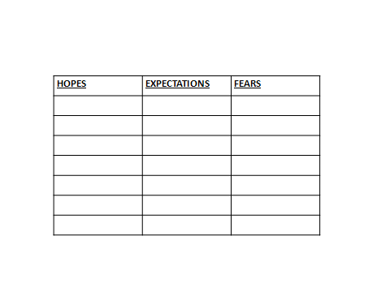
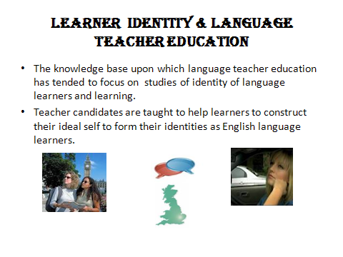
Construction of Identity in Teacher Candidates
Prof. Dr. Birsen Tütüniş
Istanbul Aydın University-birsentutunis@aydin.edu.tr
￼
ABSTRACT
Abstract:
Research into teacher identity in the wider education literature has tended to concentrate either on the development of personal beliefs and the effects of these beliefs on the way an individual understands him/ herself ( Connelly and Clandilin, 1999, MacCarthey,2001) or on the institutional role expectations and how these influence professional identity ( Geijsel and Maijers,2005). The formation of teacher identity is seldom conceptualized as a learning process. This paper will focus on the learning process of the teacher candidates and display how they form their identity as EFL teacher candidates.
Seven steps In the possIble selves mappIng process
THEORY :
POSSIBLE SELVES
Anne Marshall, PhD amarshal@uvic.ca Fran Guenette, MA francisg@uvic.ca University of Victoria, BC, Canada NCDA Conference July 9-11, 2008 Washington, DC
[

